Slide 1



PIPELINE MANAGER
From Amshuhu iTech Solutions Pvt. Ltd.
Distributor Field Lead Technical Support
Version 1.0

Slide 2
Distributor Field Lead Technical Support
Table of Contents
Acronyms
Log in Screen
D-FLTS Home Page
My Reviews
Settings
Help
Log Off

Slide 3
ACRONYMS
Distributor Field Lead Technical Support
DGM→ Distributor General Manager
DSM→ Distributor Sales Manager
DSR→ Distributor Sales Representative
D-FLTS→ Distributor Field Lead Technical support
DMM→ Distributor Marketing Manager
SPANCOP→ Suspect, Prospect, Approach, Negotiate, Close, Order, Payment.
KPI→ Key Performance Indicator
CPT→ Coverage penetration Throughput
OEM→ Own equipment manufacturers.
GKA→ Global Key Account
OWL→ Open, Won and Lost

Slide 4
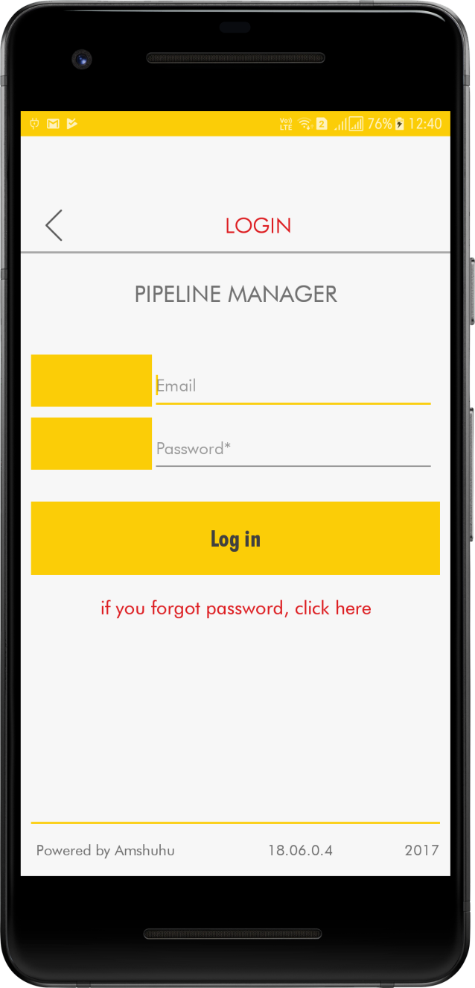
Distributor Field Lead Technical Support
Login Screen
In the Login screen by entering the User name and Password credentials you can gain access to the application.

Slide 5
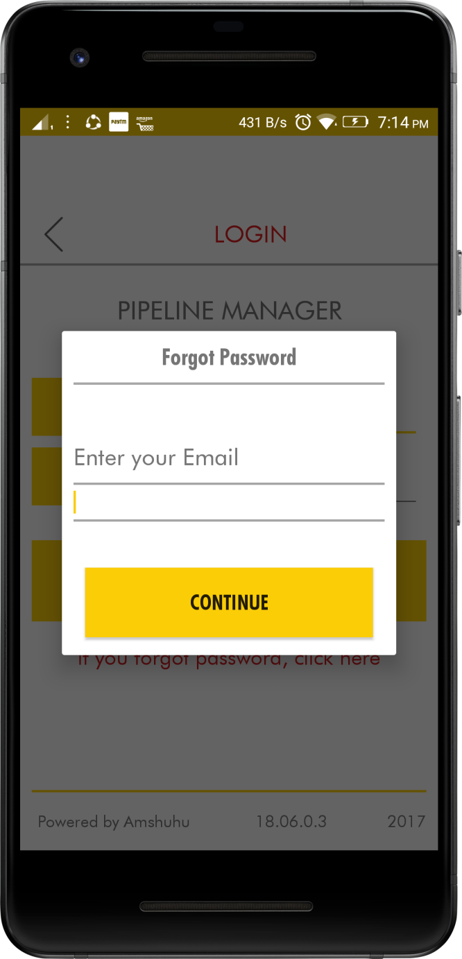
Distributor Field Lead Technical Support
If you forget your password, you can always click on the “if you forgot password, click here” link below the login button and follow the instructions to recover your password or get a new one.

Slide 6
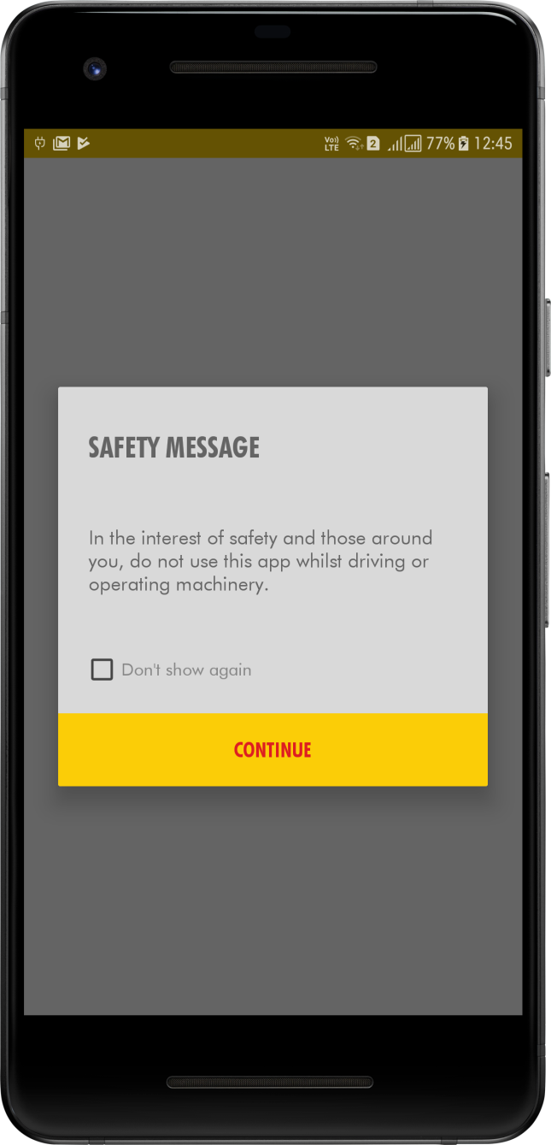
Distributor Field Lead Technical Support
In Safety measure screen click on the check mark and press Continue.

Slide 7
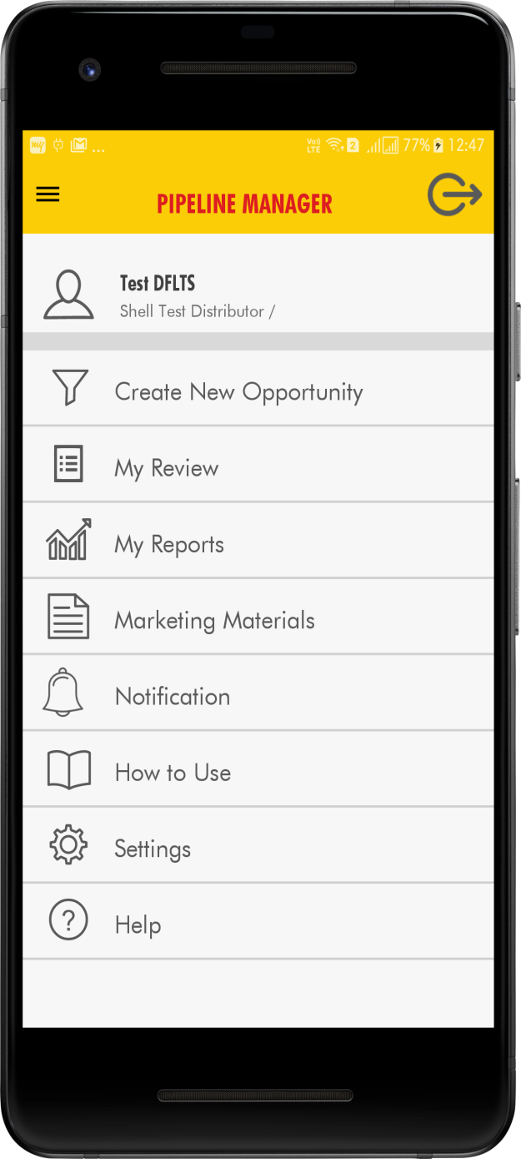
Distributor Field Lead Technical Support
DFLTS Home Page
Create> New Opportunity tab, allows the User to create a new lead.
My Review tab, the user gets to view the status of users Annual Target and Pipeline strength.
How to use tab, takes the user to a user’s manual for the application.
Settings tab, allows the user to manage the users profile and the mobile app notifications settings
Help
Log out tab, allows the user to Log out of the application.

Slide 8
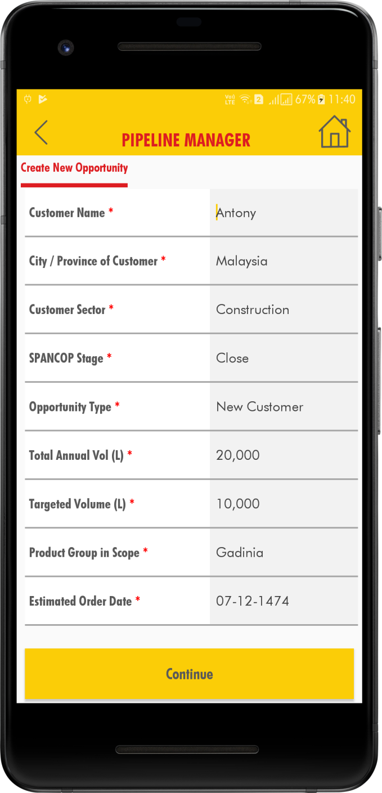
Distributor Field Lead Technical Support
Create New Opportunity
When clicked on the Create New Opportunity tab, the below screen appears allowing the user to enter the data for a new lead. After entering all the data, the new Opportunity is created for that particular DSR.

Slide 9
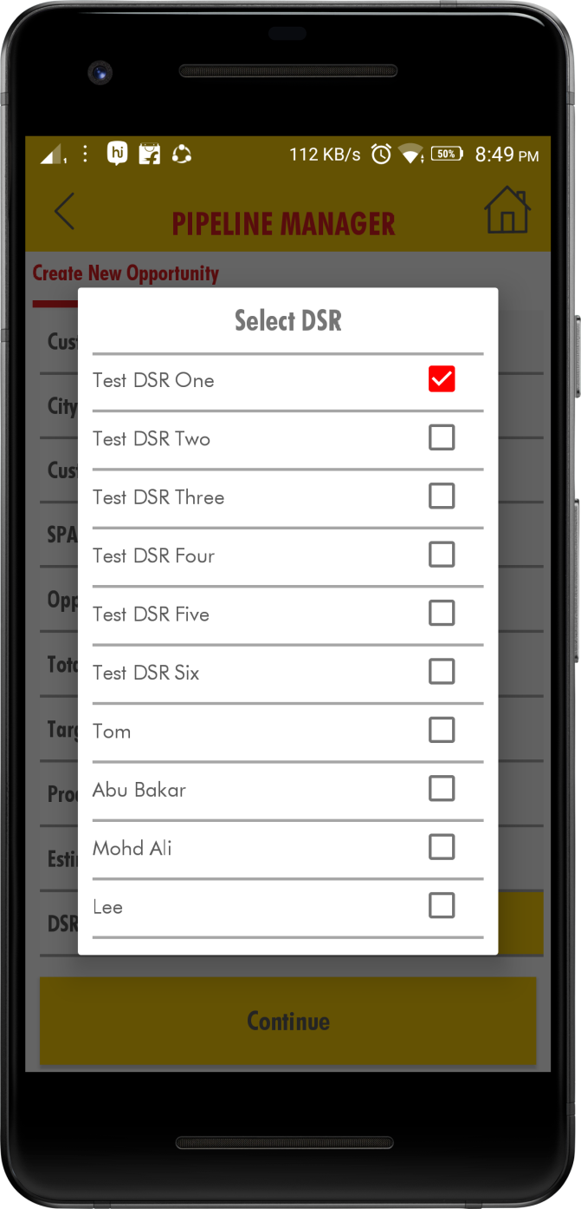
Distributor Field Lead Technical Support
Select the DSR name from drop down list.

Slide 10
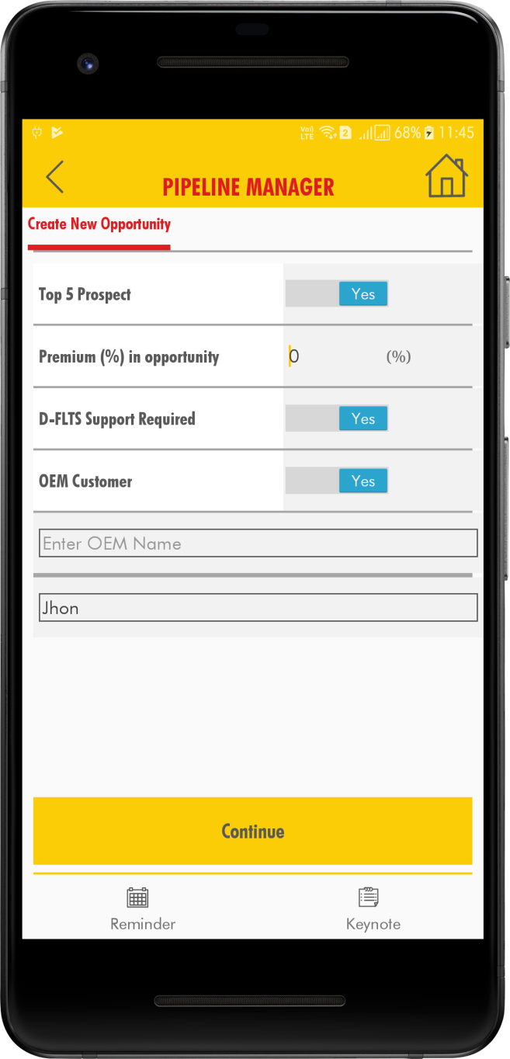
Distributor Field Lead Technical Support
After entering all the data, the new Opportunity is created for that particular DSR.

Slide 11
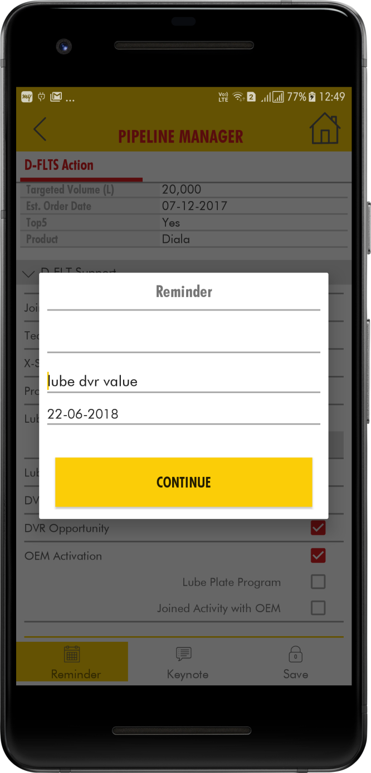
Distributor Field Lead Technical Support
Click on the Reminder and select the date from the dropdown.

Slide 12
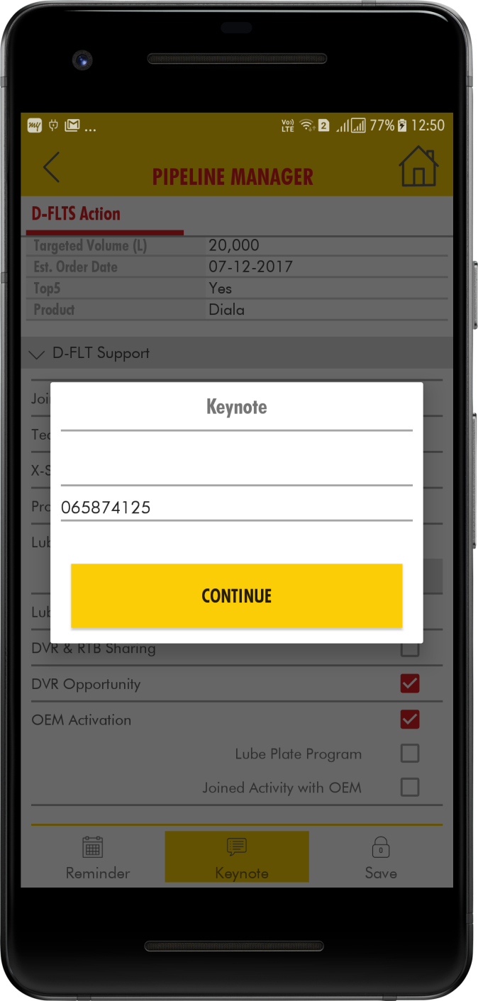
Distributor Field Lead Technical Support
Click on the Key Notes and enter the text and then click Continue

Slide 13
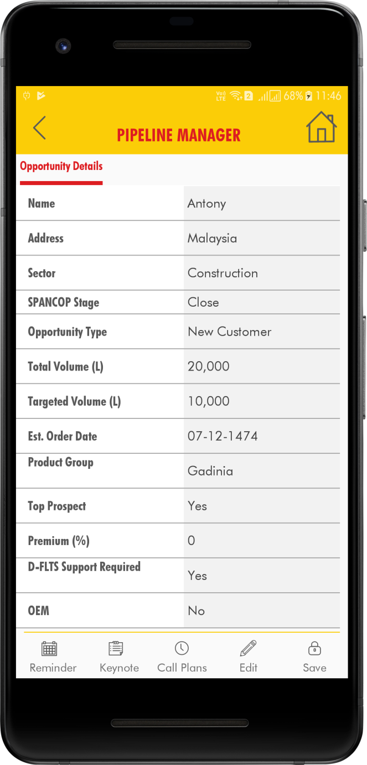
Distributor Field Lead Technical Support
After entering all the field’s click on the ‘Save’ button

Slide 14
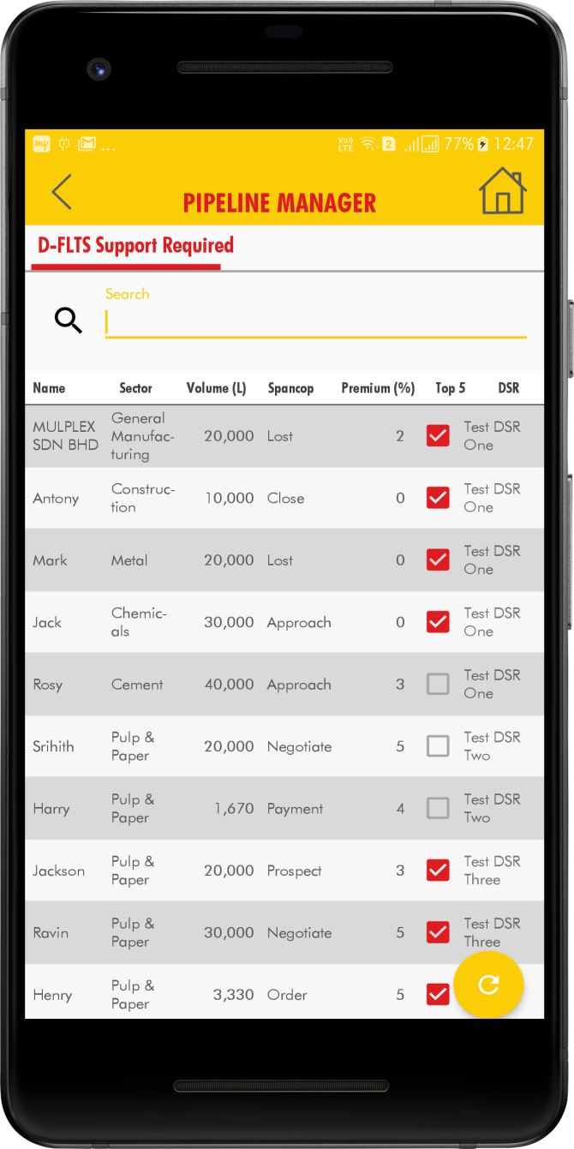
Distributor Field Lead Technical Support
My Review
When clicked on the My Review tab the below screen appears. In this view, the list of all the opportunities who required the D-FLT Support.

Slide 15
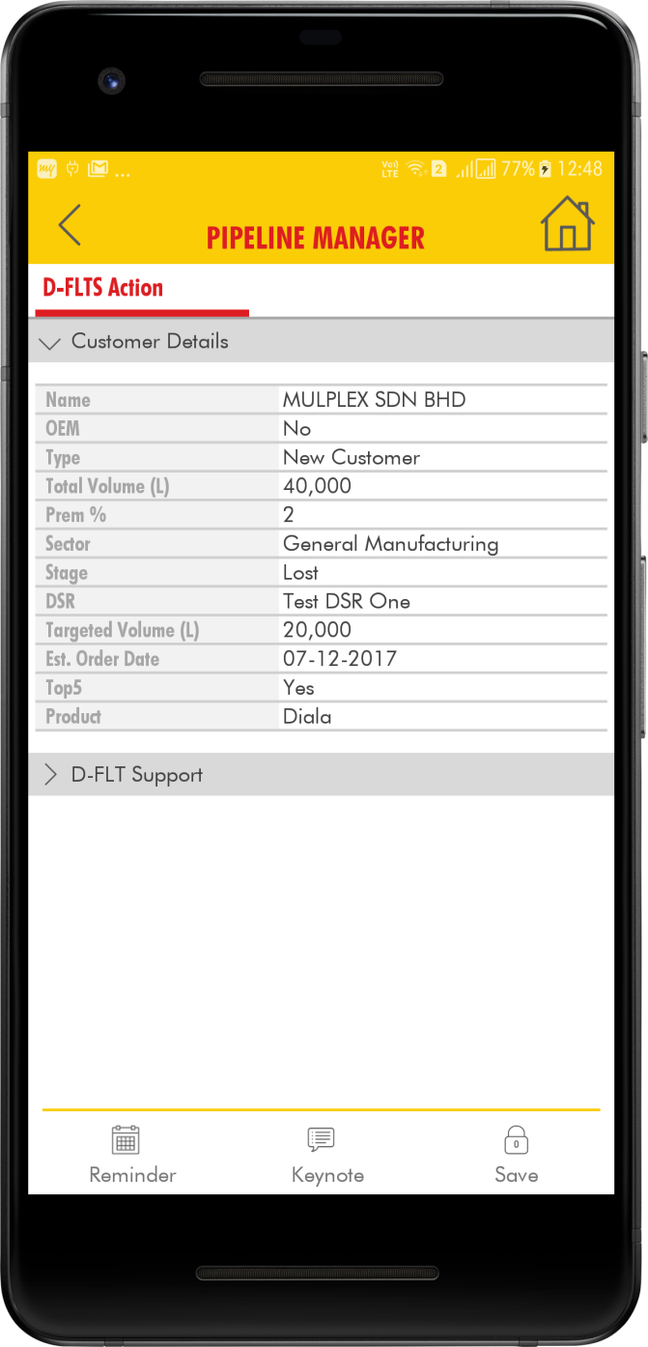
Distributor Field Lead Technical Support
By clicking on the specific Opportunity. The below screen appears with opportunity details. In D-FLT Support tick the check box from the list.

Slide 16
Distributor Field Lead Technical Support
After clicking on the ‘Save’ button ‘Saved Successfully message is appeared.

Slide 17
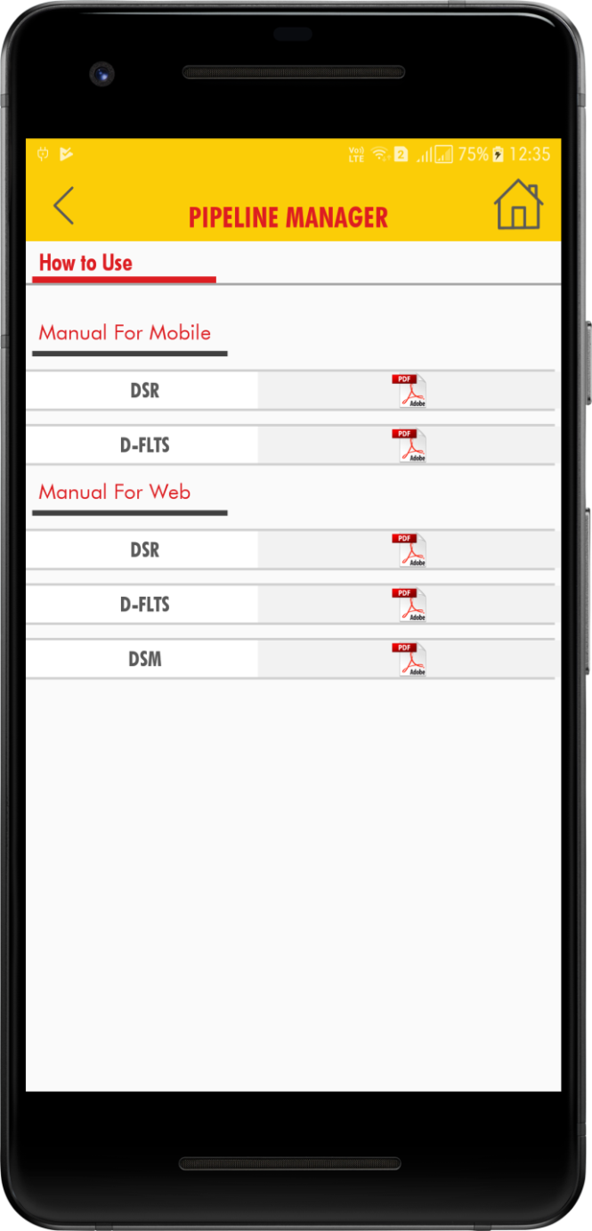
How To Use
Distributor Field Lead Technical Support
After clicking on the How To Use tab, the below screen is displayed with Manuals in PDF Format.

Slide 18
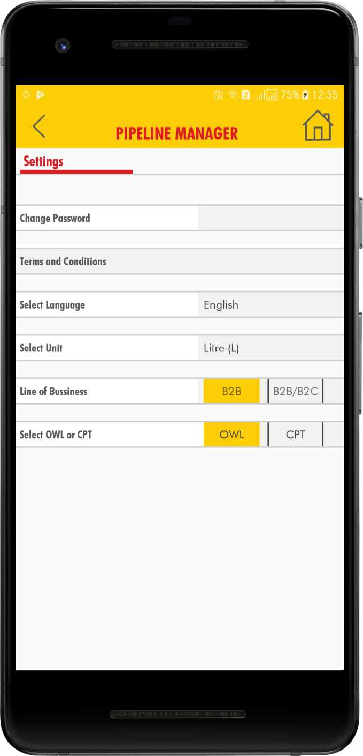
Distributor Field Lead Technical Support
Settings
After clicking on the Settings tab, the below screen is displayed with Select Language, Select Unit and Change Password.

Slide 19
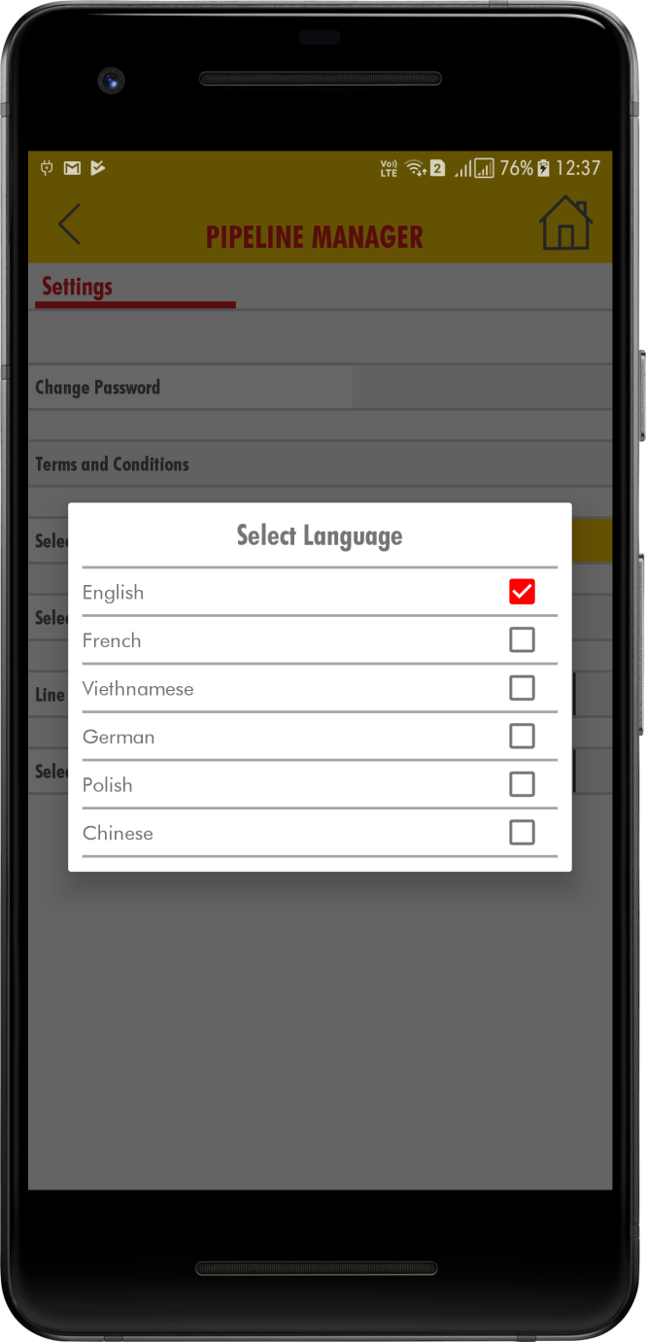
Distributor Field Lead Technical Support
Click on the Select Language, the pop up window is appeared with different languages. Then we can the select language.

Slide 20
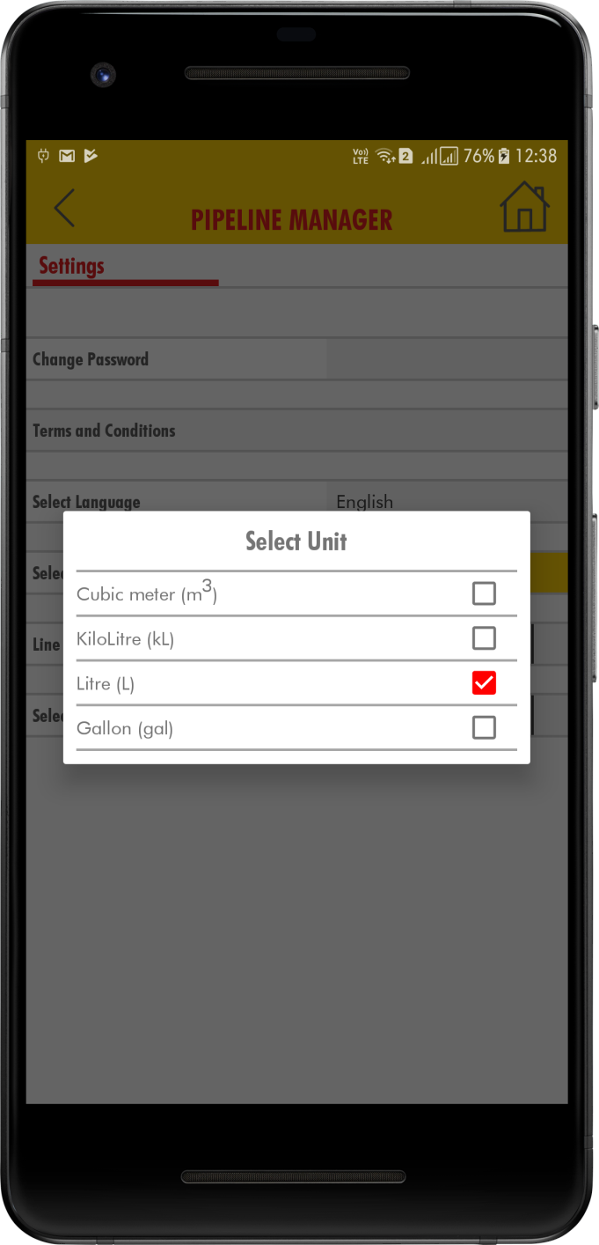
Distributor Field Lead Technical Support
Click on the Select Unit, the pop up window is appeared with different Units. In that we can select the Units Cubic meter or Kilo Litre.

Slide 21
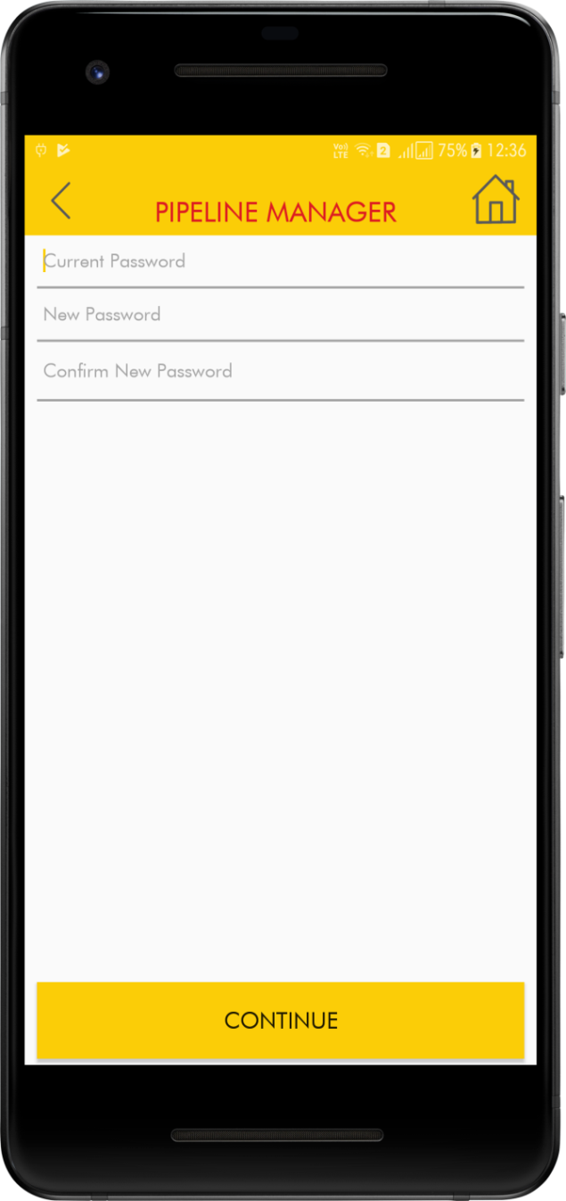
Distributor Field Lead Technical Support
Click on the Change Password, the below screen displayed with Current Password and New Password. After entering all the fields click on Continue button. Password changed successfully message appeared.

Slide 22
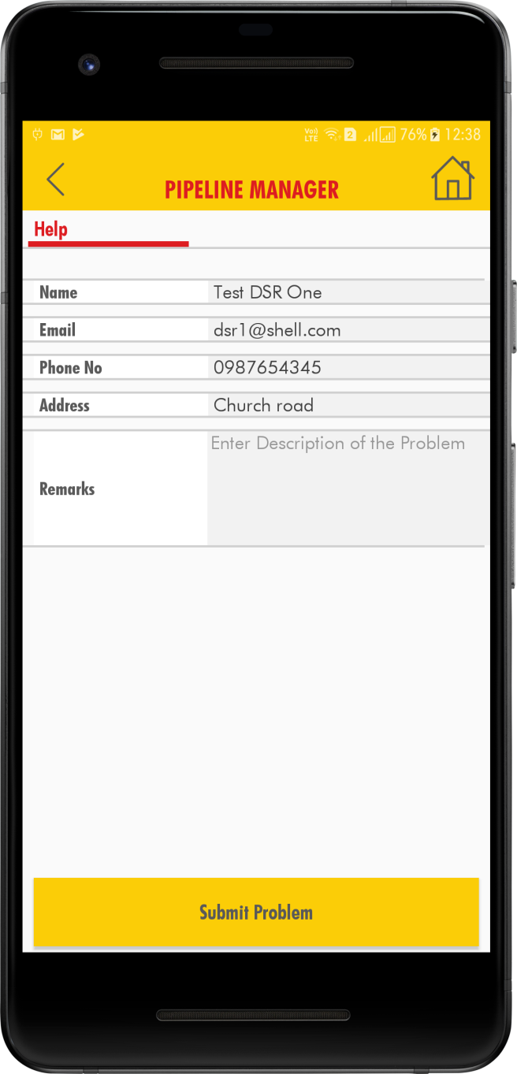
Distributor Field Lead Technical Support
HELP
After clicking on the Help tab, the below screen is displayed with Name, Email , Phone No, Address and Remarks.

Slide 23
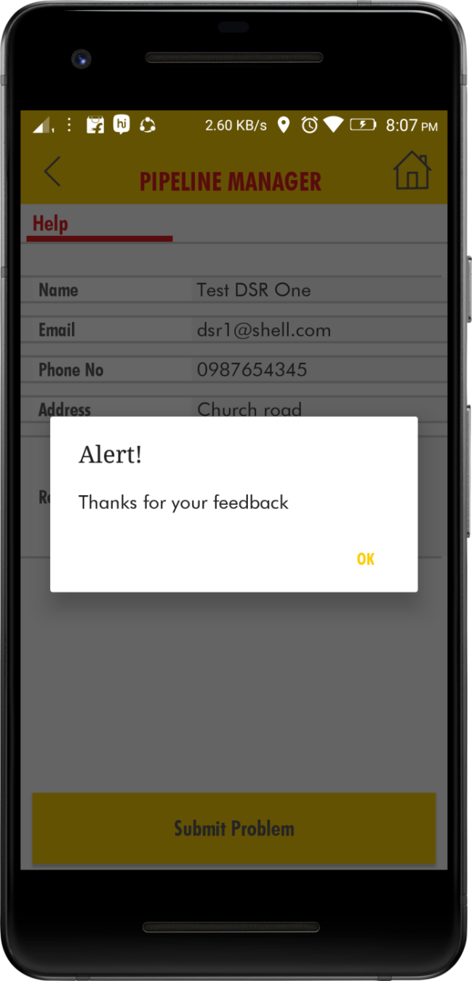
Distributor Field Lead Technical Support
After entering the Remarks click on the Submit Problem. The below screen is appeared with alert message.

Slide 24
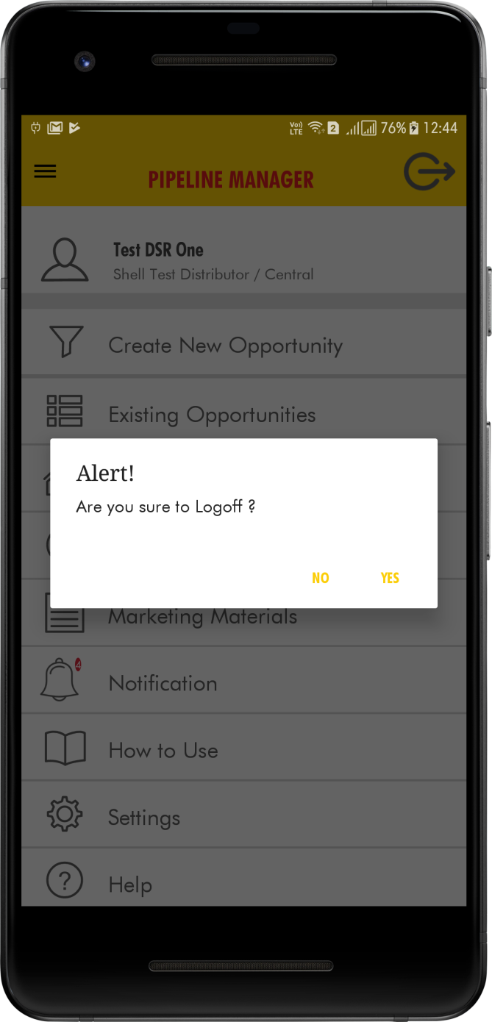
Distributor Field Lead Technical Support
Log Off
Click on the Logoff icon on the top right corner of the home page .And confirm the popup message which is shown like “Are you sure to Logoff”.

